Slide 1
Big-Data Project
Chicago Crime Data Analysis
Analysis by : Rishi Reddy Bokka

Slide 2
Description of Dataset
This dataset reflects reported incidents of crime that occurred in the City of Chicago from 2001 to present. Data is extracted from the Chicago Police Department's CLEAR (Citizen Law Enforcement Analysis and Reporting) system
url : https://data.cityofchicago.org/Public-Safety/Crimes-2001-to-present/ijzp-q8t2
Size : 1.34 GB
Format : Comma separated (CSV)

Slide 3
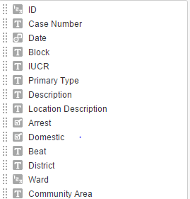
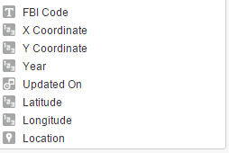
Attributes Description

Slide 4
Technologies used
Hadoop -2.7.1
Hbase – 0.94.27
Pig -0.13.0
Hive – 1.1.1
Impala – 2.2
Map-Reduce
Visualization Tool:
Tableau 9.0

Slide 5
Aim of the Project
Analyzing the performance of Hadoop Eco-System tools (Pig, Hive and Impala) on the given dataset

Slide 6
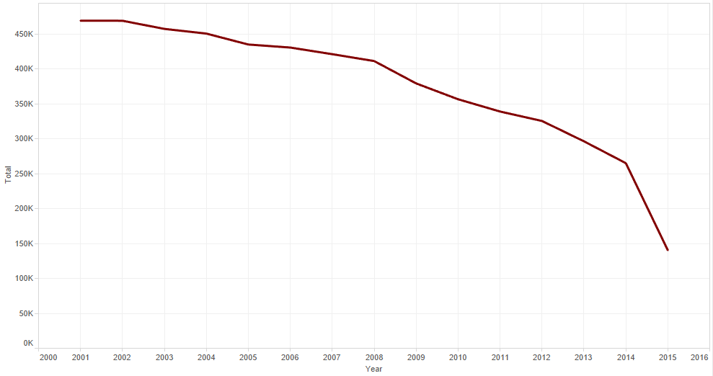
Crime distribution by Year

Slide 7
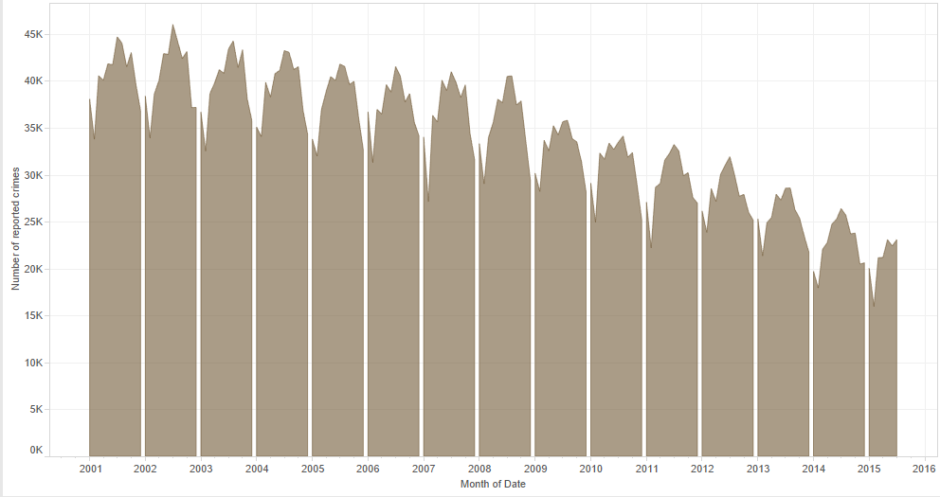
Crimes distribution by Month-Year

Slide 8
Crime distribution by Months
Criminals like warm weather
Top 4 months: July, August, June and May
Criminals have less activities in winter time
Top 4 months : February, December, January, November

Slide 9
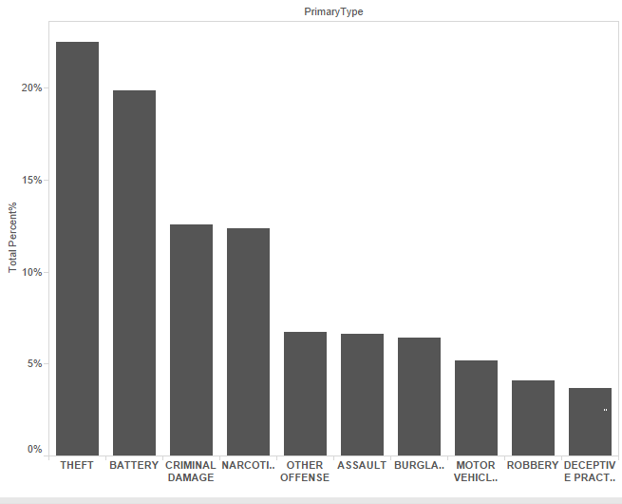
Crime distribution by Primary Type

Slide 10
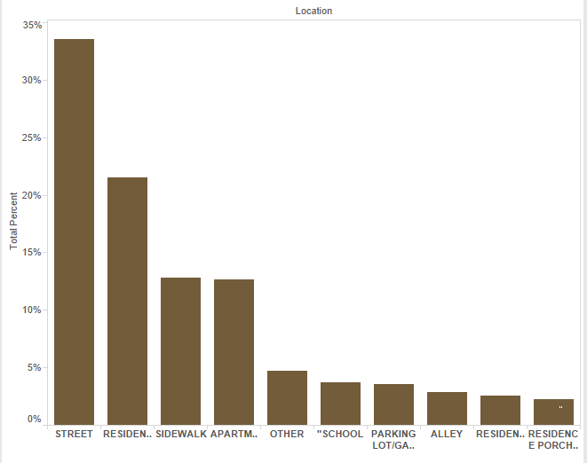
Crime distribution by Location Description

Slide 11
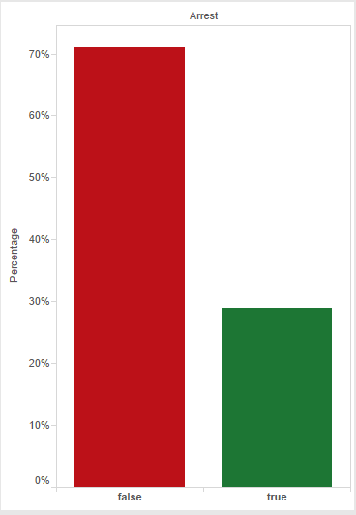
Percentage of reported crimes by Arrest

Slide 12
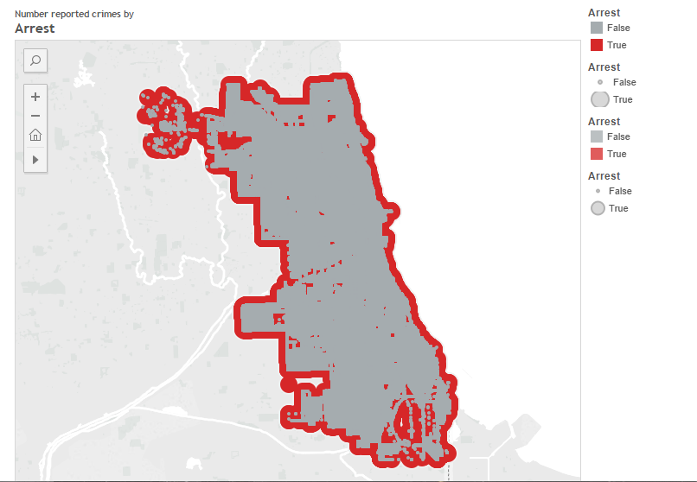
Geo-mapping representation by Arrests

Slide 13
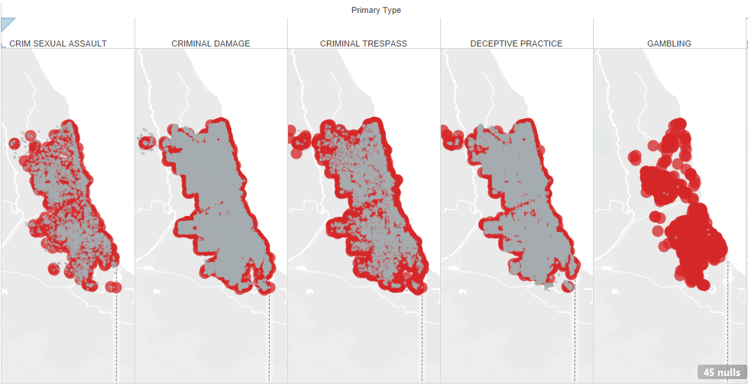
Geo-mapping representation by Arrest vs Primary Type

Slide 14
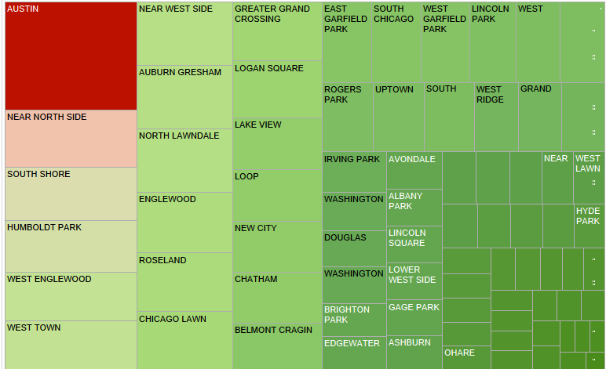
Crime distribution across Communities

Slide 15
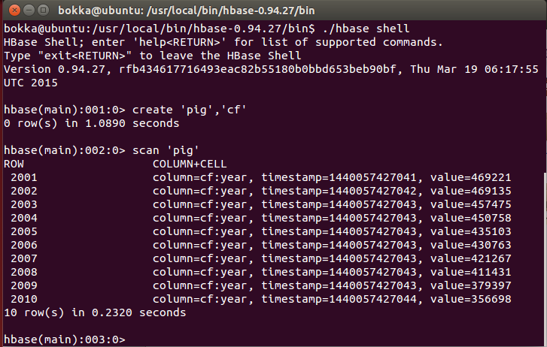
Storing output from Pig on Hbase

Slide 16
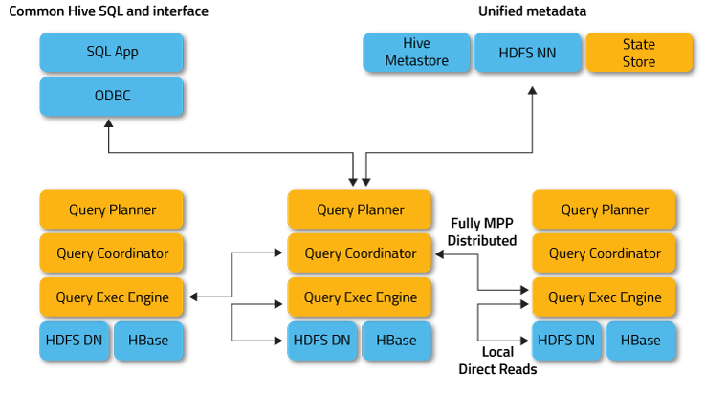
Pig vs Hive vs Impala
Impala Architecture

Slide 17
Impala Architecture
Impala Daemon
  runs on every node
  handles client requests
  handles query planning & execution
State Store Daemon
  provides name service
  metadata distribution
  used for finding data

Slide 18
Performance based on Time
On an average time of execution of Pig , Hive and Impala while performing above analysis:
Pig : 342 sec
Hive : 171 sec
Impala : 19 – 20 sec

Slide 19
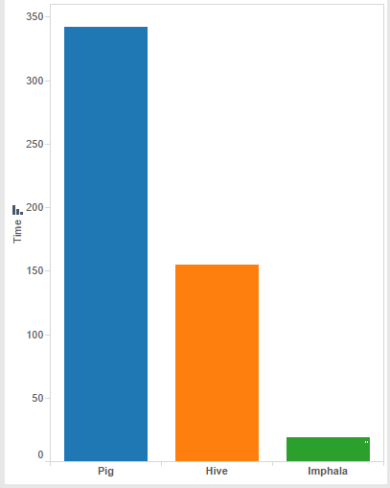

Performance based on Time

Slide 20
Thank You

